Slide 1

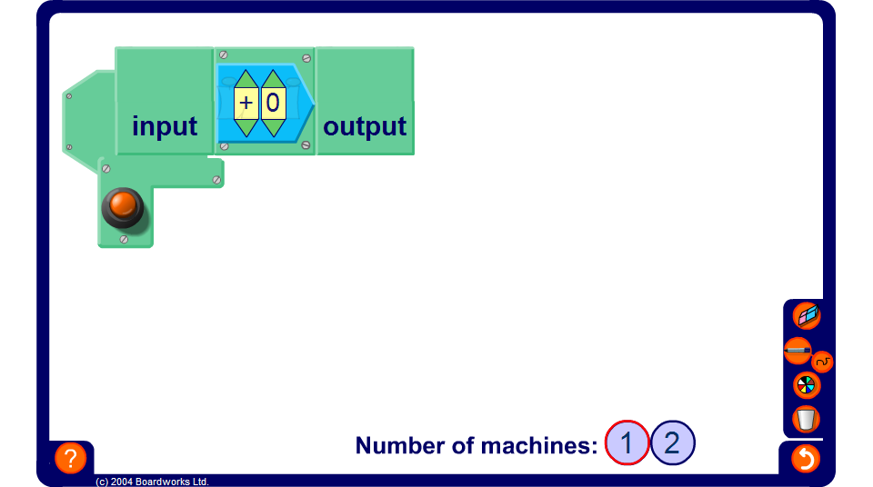


Writing functions using algebra
Notes:
Explain that for this function machine we input x. This will give us the output in terms of x. We can then write the function as an equation or with a mapping arrow.
Explain the difference between these two forms of writing a function.
Hide the output and ask pupils how given functions can be written algebraically. Show the intermediate steps if required.

